Slide 1
Clustering
Three different clustering algorithms were implemented
k-Means
Hierarchical
DBSCAN
Purpose
If clusters are present, we can see what the clusters consist of to give us new insights
Example: Maybe there’s a cluster of students with divorced parents?

Slide 2
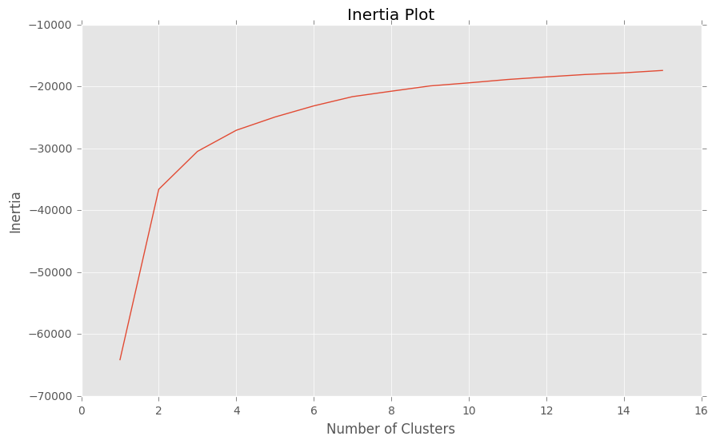
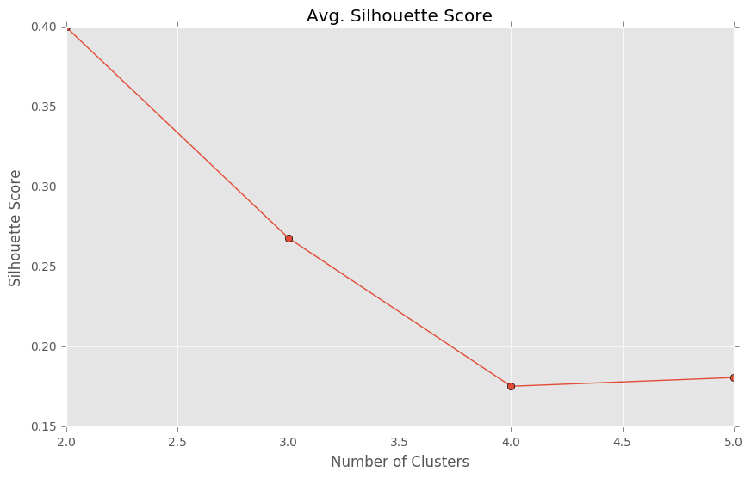
k-Means
Tried one through fifteen clusters
Decided to focus on two through five clusters
Silhouette Score (measure of distance from other clusters) wasn’t promising
+1 is best, -1 is worst

Slide 3
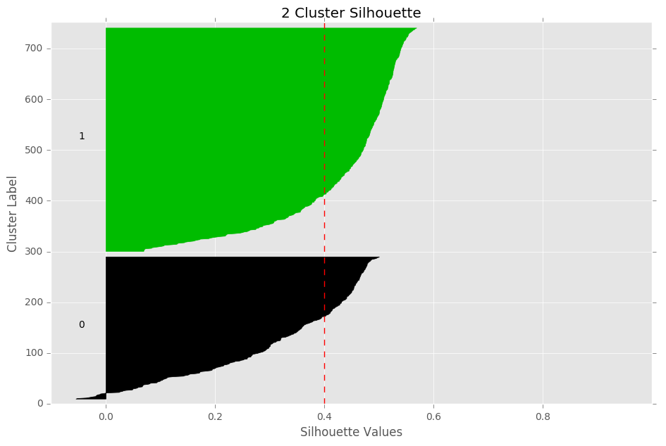
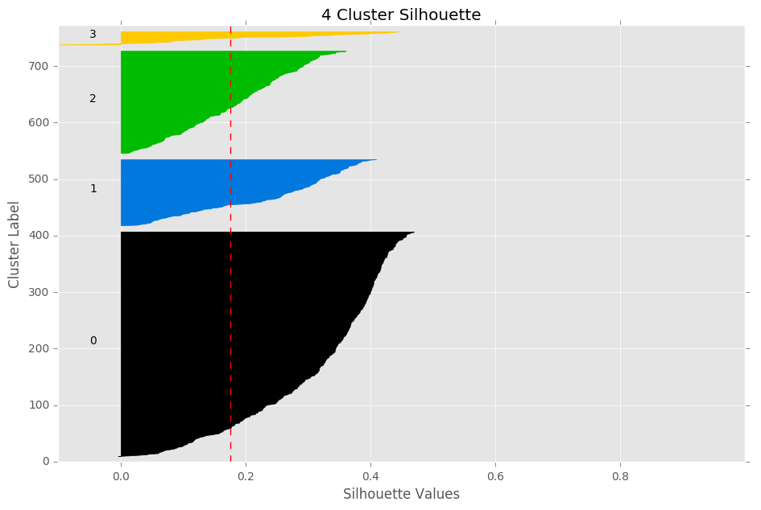
k-Means Silhouette Plots
Silhouettes aren’t close to +1, shape isn’t boxy

Slide 4
What about Hierarchical?

Slide 5
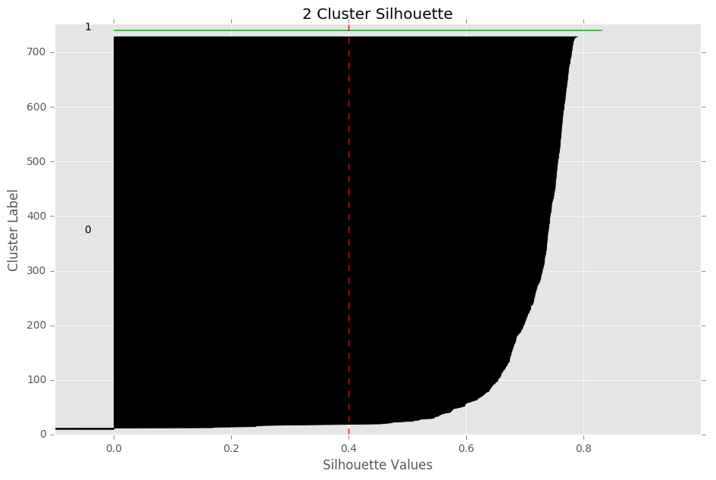
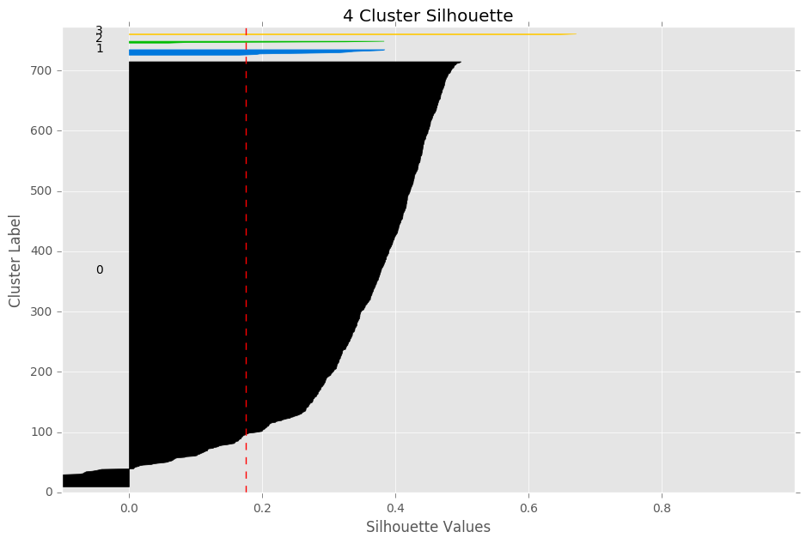
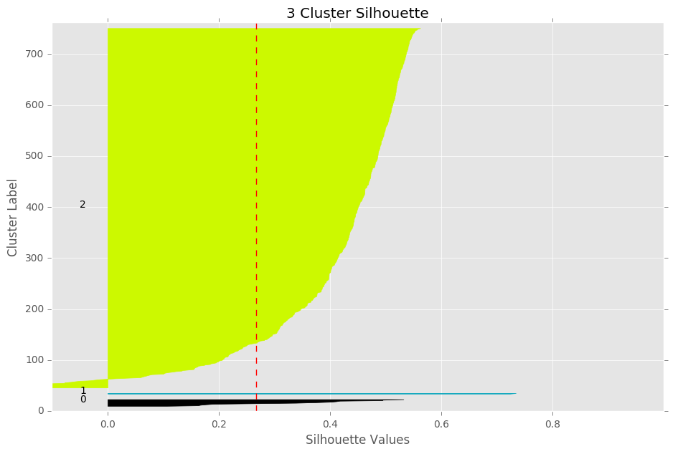
Hierarchical Silhouette Plots

Slide 6
DBSCAN
Tried one last algorithm, DBSCAN
DBSCAN determines the number of clusters for you
DBSCAN classified all points as noise
This may imply that there are no real clusters, or one large cluster

Slide 7
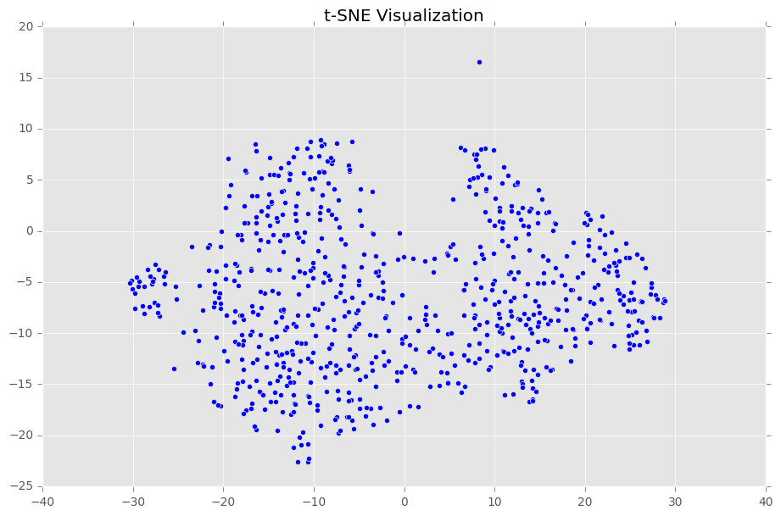
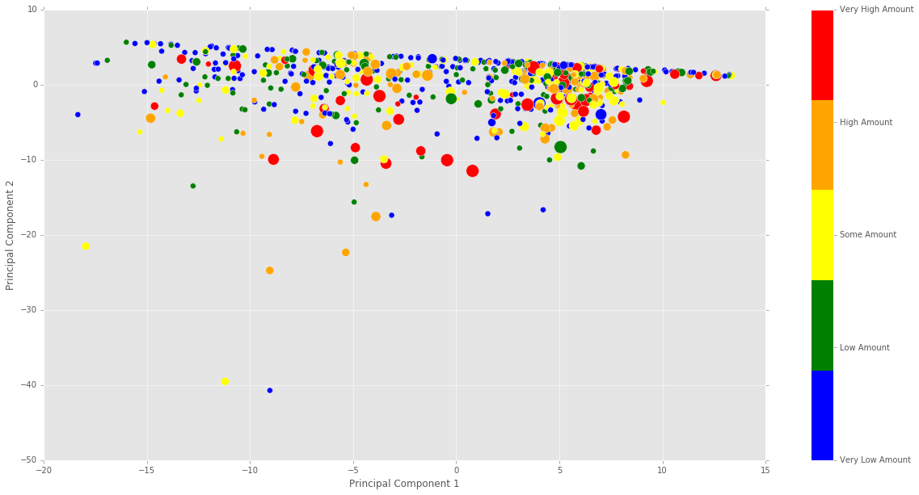
Dimensionality Reduction - Visualization
t-SNE
PCA

Slide 8
Survey

Slide 9
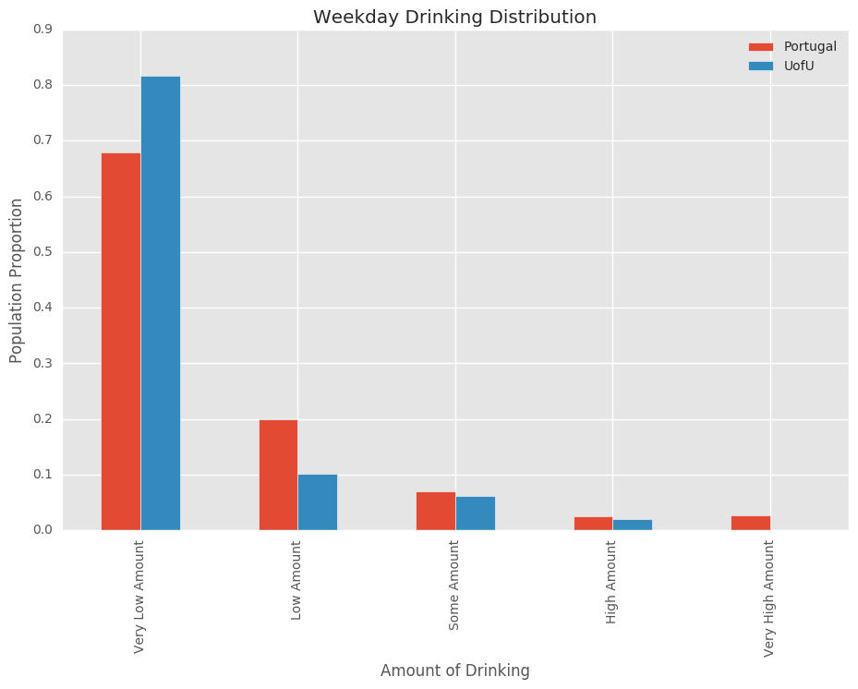
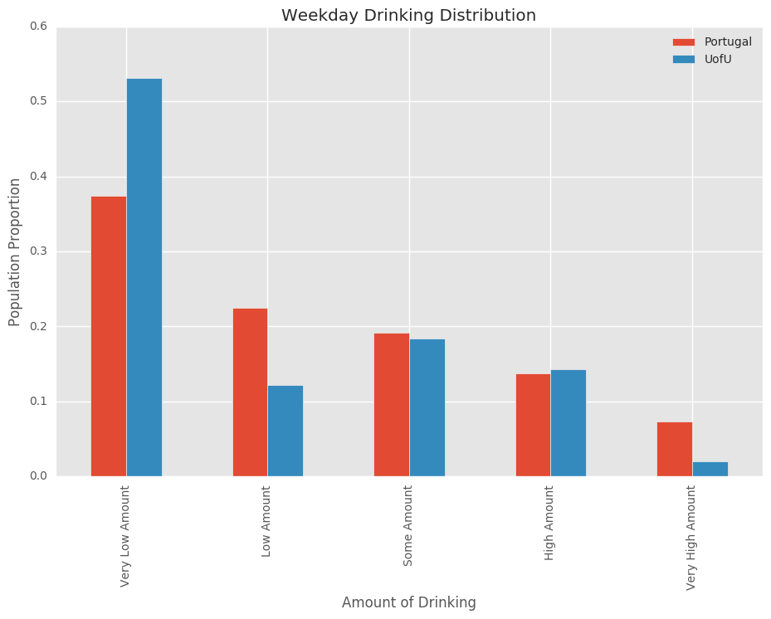
Alcohol Consumption

